Slide 1
Hanwell Catchment Study
Presented on June 11, 2015

Slide 2
Background
To study the Hanwell Community catchment area and look at enrolments, functional capacity and transportation demographics for schools receiving Hanwells students.
Request came from DEC in August, 2014, to have a broad-scope look at this area to determine if there is a need for further study.
Students living in this catchment area spend an average time of 28 minutes on the bus.
There are 578 students who have a “Hanwell” address.

Slide 3
Enrolments of Hanwell Students
School | Grade | Number of Students
Priestman Street Elementary | K | 37
 | 1 | 47
 | 2 | 40
 | 3 | 29
 | 4 | 44
 | 5 | 50
Total |  | 247
Garden Creek Elementary | K | 0
 | 1 | 3
 | 2 | 0
 | 3 | 1
 | 4 | 4
 | 5 | 0
Total |  | 8
Kingsclear Consolidated School | K | 0
 | 1 | 1
 | 2 | 1
 | 3 | 2
 | 4 | 0
 | 5 | 0
Total |  | 4
George Street Middle School | 6 | 42
 | 7 | 47
 | 8 | 40
Total |  | 129

Slide 4
Enrolments Continued
Fredericton High School | 9 | 54
 | 10 | 46
 | 11 | 47
 | 12 | 37
Total |  | 184
Bliss Carman Middle School | 6 | 0
 | 7 | 0
 | 8 | 2
Total |  | 2
Leo Hayes High School | 9 | 0
 | 10 | 0
 | 11 | 1
 | 12 | 2
Total |  | 3
Royal Road Elementary School | K | 0
 | 1 | 0
 | 2 | 0
 | 3 | 0
 | 4 | 0
 | 5 | 1
Total |  | 1
Grand Total of Students from Hanwell |  | 578

Slide 5
Functional Capacity
Education Centre | School | Grade Level | Grade Level Capacity factor | Number of Classrooms | Capacity | Calculated Capacity | Official September 2014 Enrolment | Functional Capacity 2014
Fredericton | Bliss Carman | 6-8 | 29 | 24 | 728 | 696 | 604 | 86.8%
Fredericton | Fredericton High | 9-12 | 29 | 97 | 2716 | 2813 | 1909 | 67.9%
Fredericton | Garden Creek | K-5 | 24 | 16 | 384 | 384 | 276 | 71.9%
Fredericton | George Street Middle | 6-8 | 29 | 34 | 952 | 986 | 649 | 65.8%
Fredericton | Keswick Ridge | K-8 | 26 | 9 | 234 | 234 | 170 | 72.6%
Fredericton | Kingsclear | K-5 | 24 | 5 | 120 | 120 | 101 | 84.2%
Fredericton | Leo Hayes High | 9-12 | 29 | 65 | 1820 | 1885 | 1747 | 92.7%
Fredericton | New Maryland | K-5 | 24 | 28 | 672 | 672 | 465 | 69.2%
Fredericton | Priestman Street | K-5 | 24 | 22 | 528 | 528 | 525 | 99.4%
Fredericton | Royal Road. | K-5 | 24 | 18 | 432 | 432 | 391 | 90.5%

Slide 6
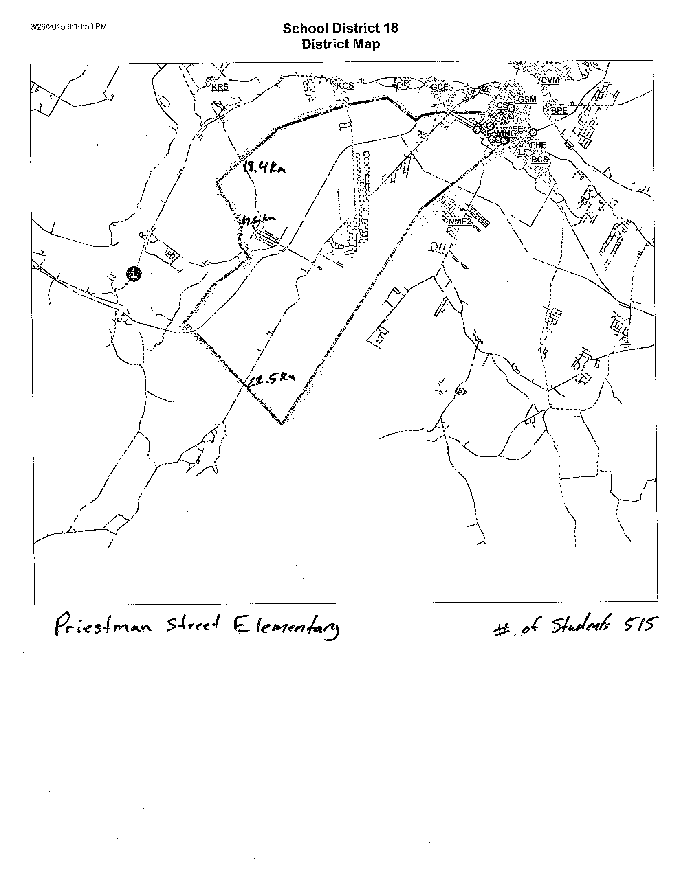
Catchment Area Maps

Slide 7
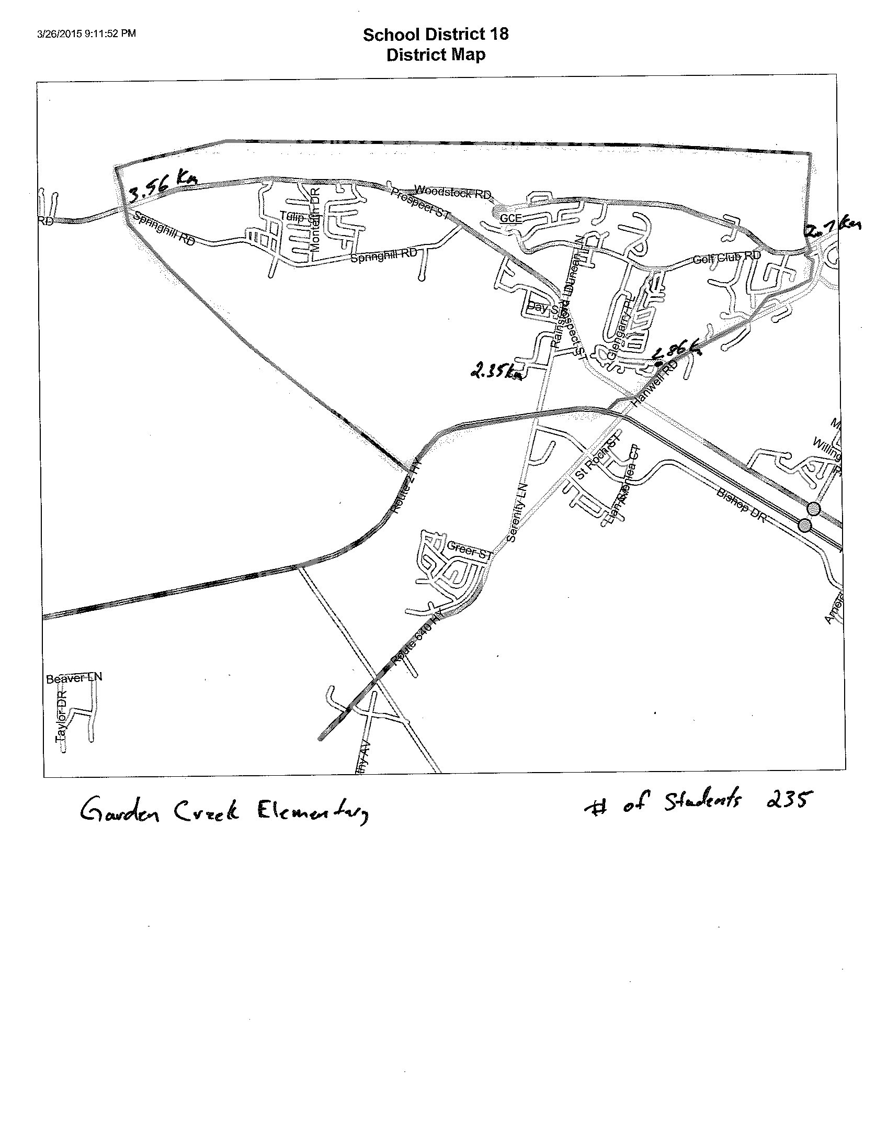
Catchment Area Maps

Slide 8
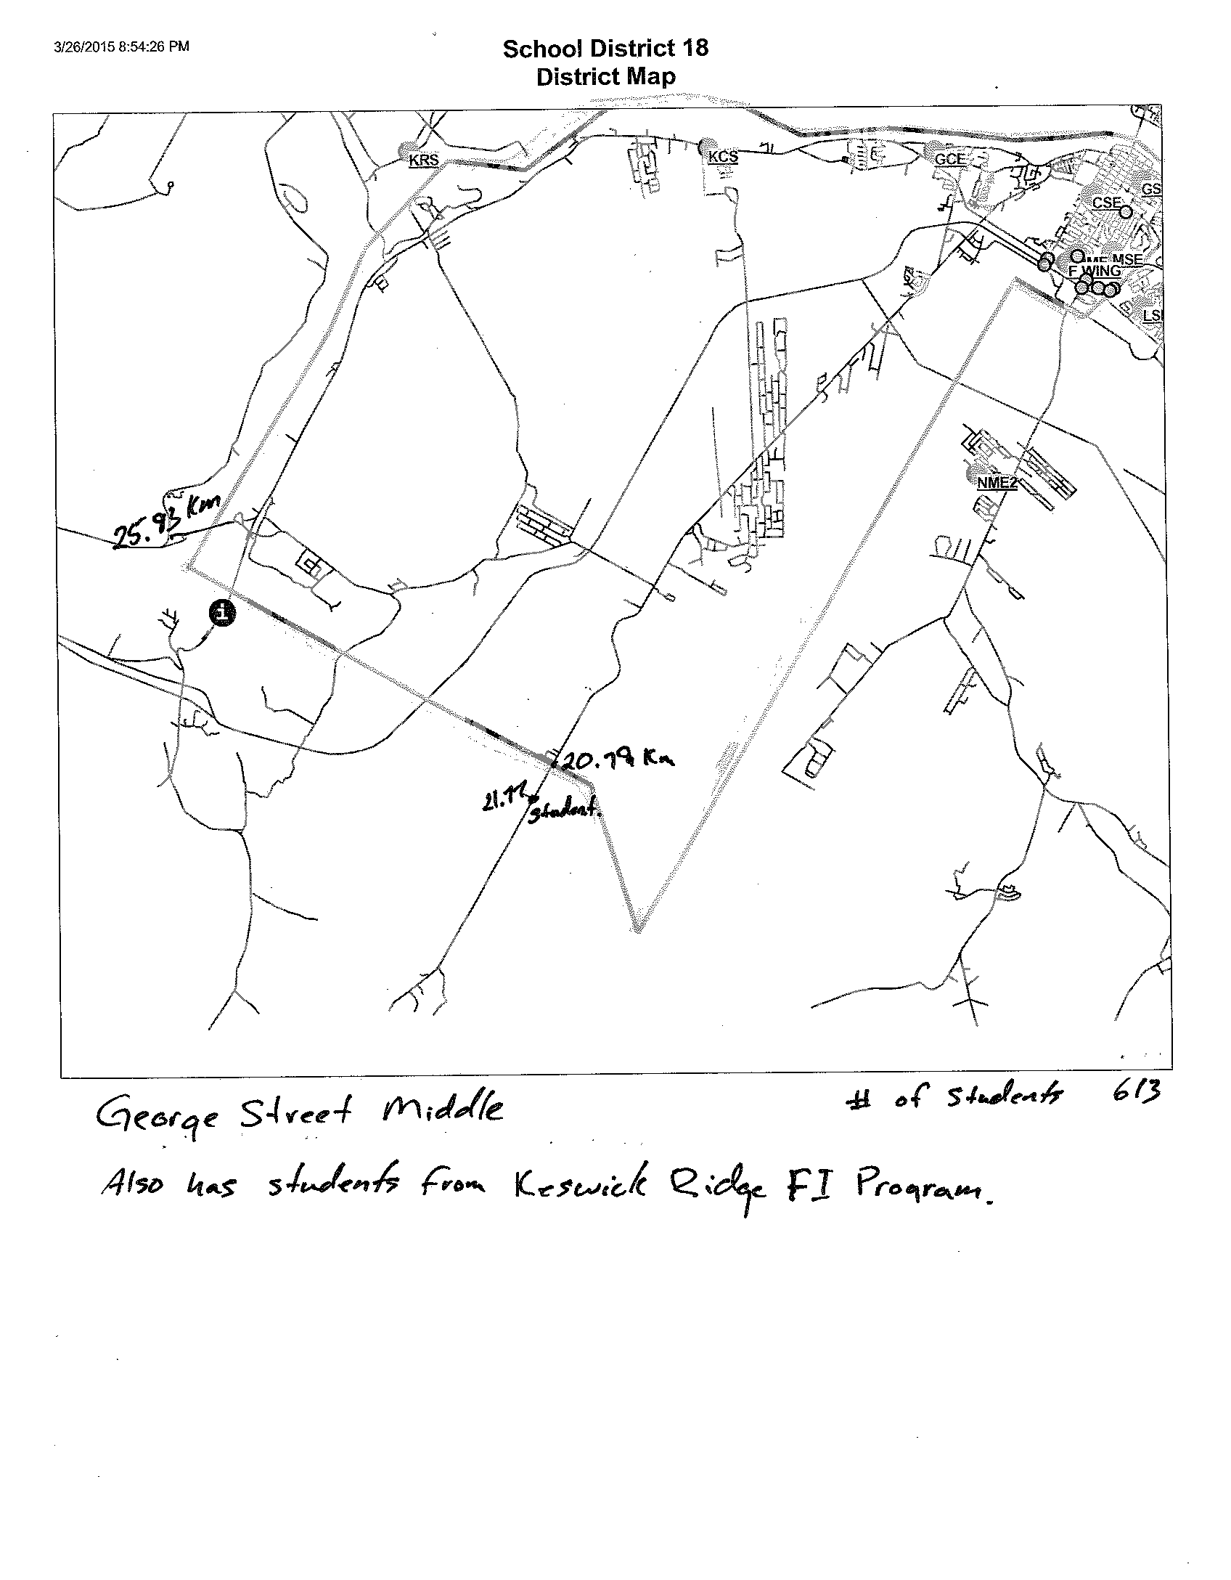
Catchment Area Maps

Slide 9
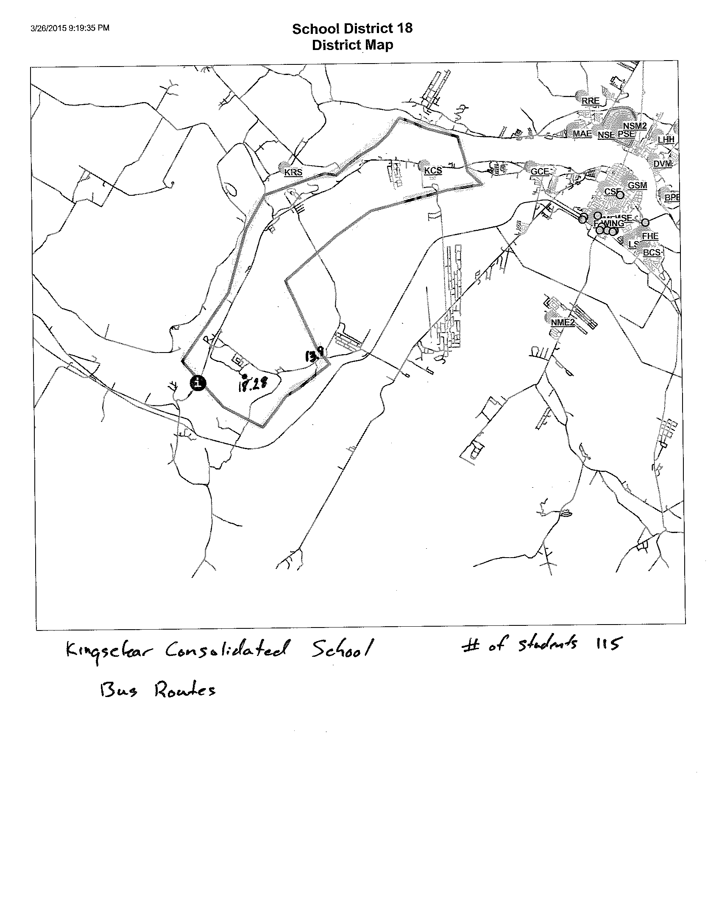
Catchment Area Maps

Slide 10
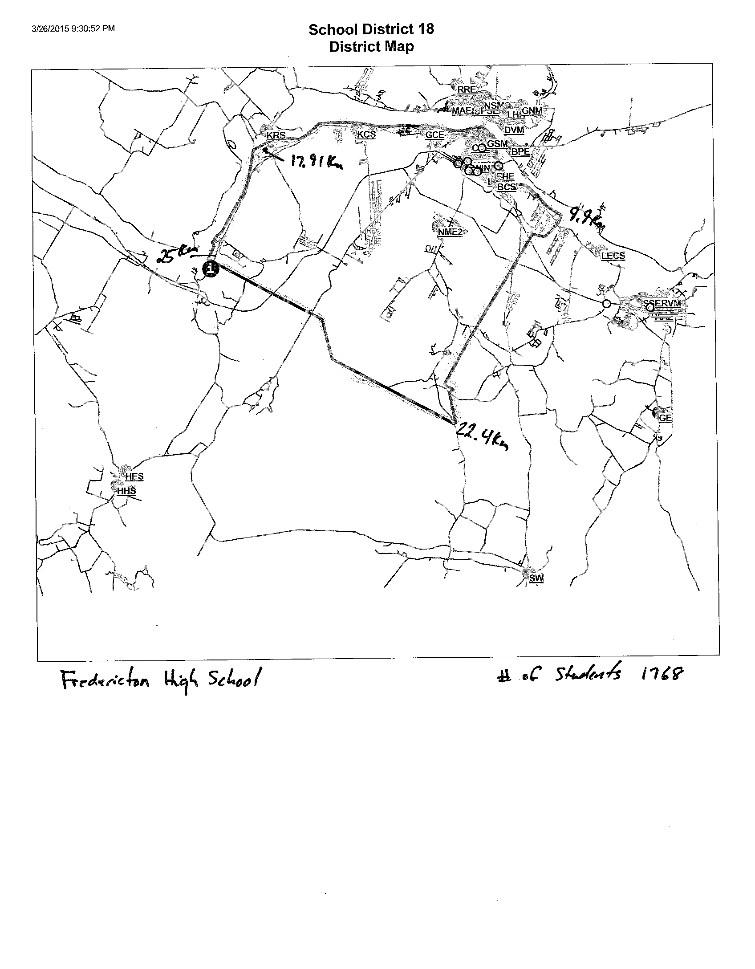
Catchment Area Maps

Slide 11
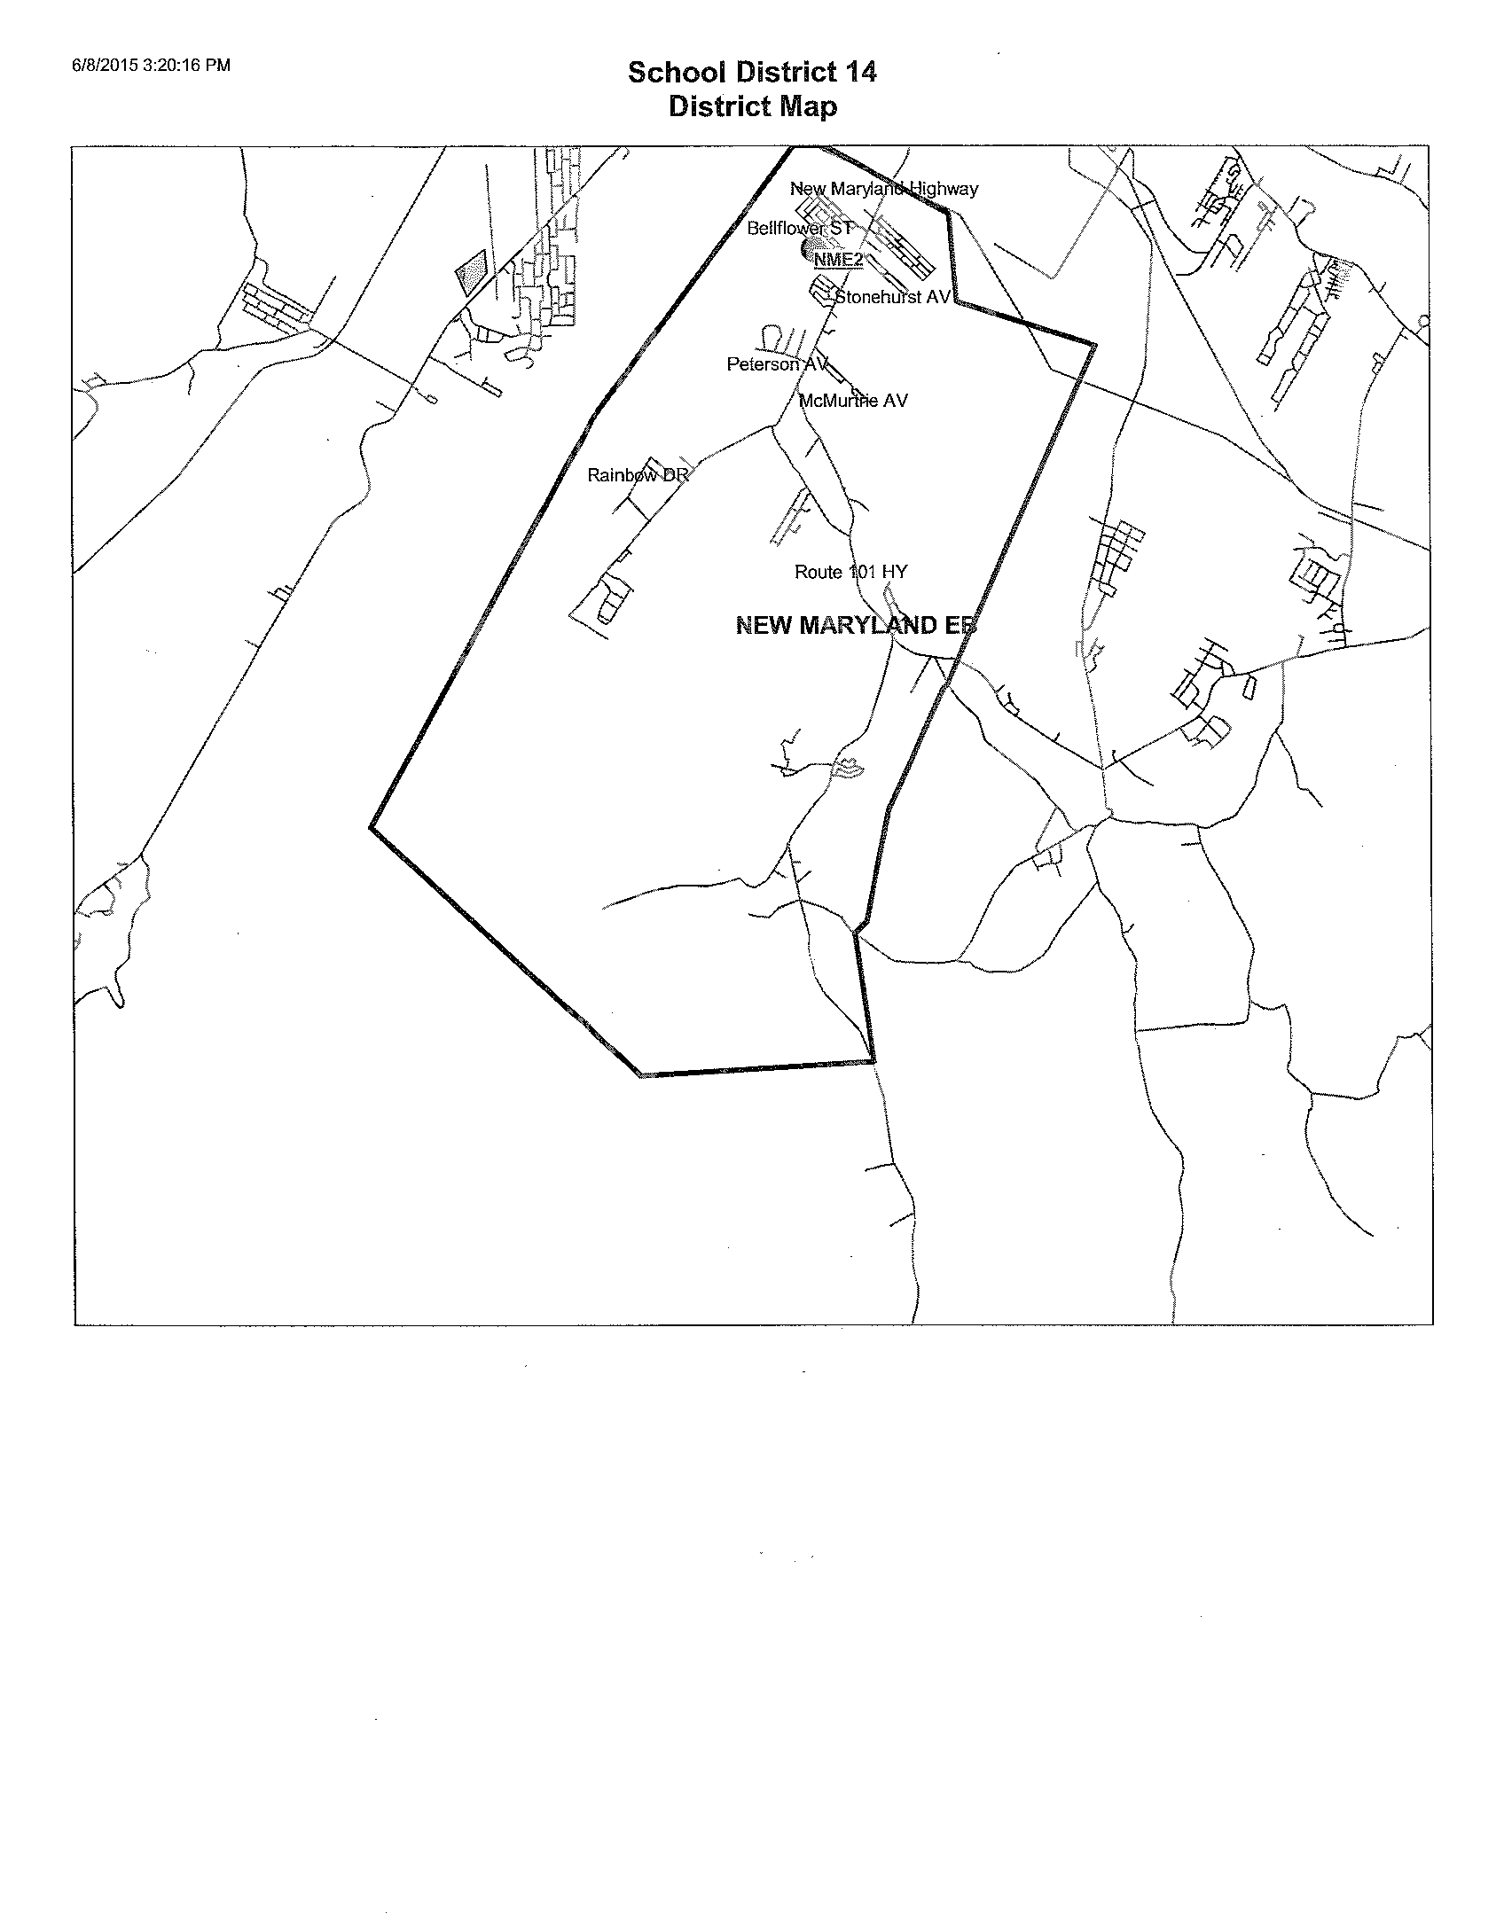
Catchment Area Maps

Slide 12
Possible Scenarios
Elementary
Option # 1 – If Kingsclear Consolidated School (KCS), Garden Creek Elementary School (GCES) and Connaught Street Elementary School (CSES) were to close and Ludford Sub-Division were to accompany these students into a new, K – 5 school, it would be approximately 630 students at the new school. This would take 41 students from Priestman Street Elementary School (PSES). The estimated capital improvement costs associated with these three schools is currently at $4,226,500. In addition to the capital improvement projects there could be a major capital avoidance of $1,800,000 for a new gym/cafeteria/kitchen at CSES.
Option #2 – If KCS, GCES and CSES were to close and Ludford Sub-Division and Hanwell area students were to accompany these students into a new, K – 5 school, it would be approximately 620 students at the new school. CSES students would then go to PSES giving them 506 students. . Estimated capital improvement costs associated with these three schools is currently at $4,226,500. In addition to the capital improvement projects there could be a major capital avoidance of $1,800,000 for a new gym/cafeteria/kitchen at CSE.

Slide 13
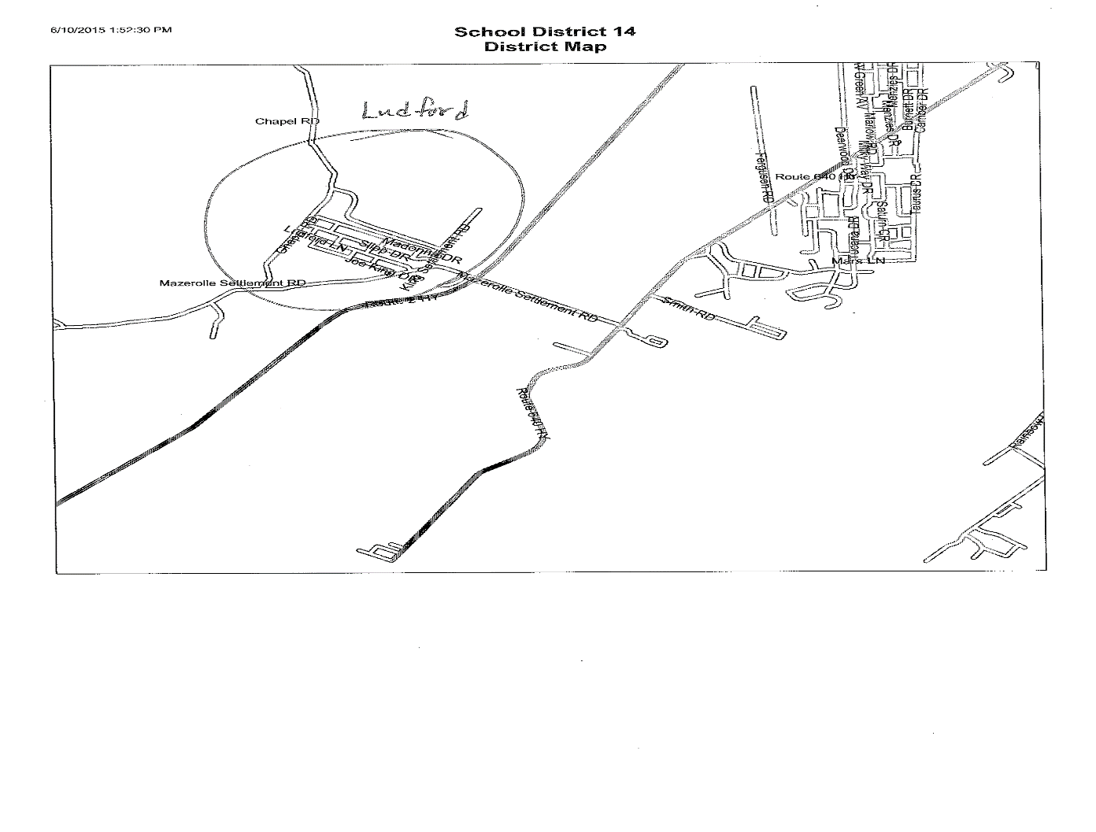
Ludford Area Map

Slide 14
Possible Scenarios
Middle
Option #1 – If George Street Middle School (GSMS) and Keswick Ridge School (KRS) were to close and Keswick Valley Memorial School (KVMS) was to change to a K – 5 school; a new middle school could be built for grade 6 – 8 students from KVMS, GSMS, KRS and the KRS grade K -5 students could attend KVM. The proposed new middle school would have approximately 710 students, KVMS would have 276 students. Estimated capital improvement costs associated with these two schools is currently $4,360,000.

Slide 15
Possible Scenarios
Could pull approximately 125 elementary students from right side of New Route 2 in Hanwell and send them to New Maryland Elementary School. This would change New Maryland functional capacity to 87.5% and student population would be 590 and reduce Priestman functional capacity to 76.1% with a student population of 400, which could provide options to look at Kingsclear Consolidated School students.

Slide 16
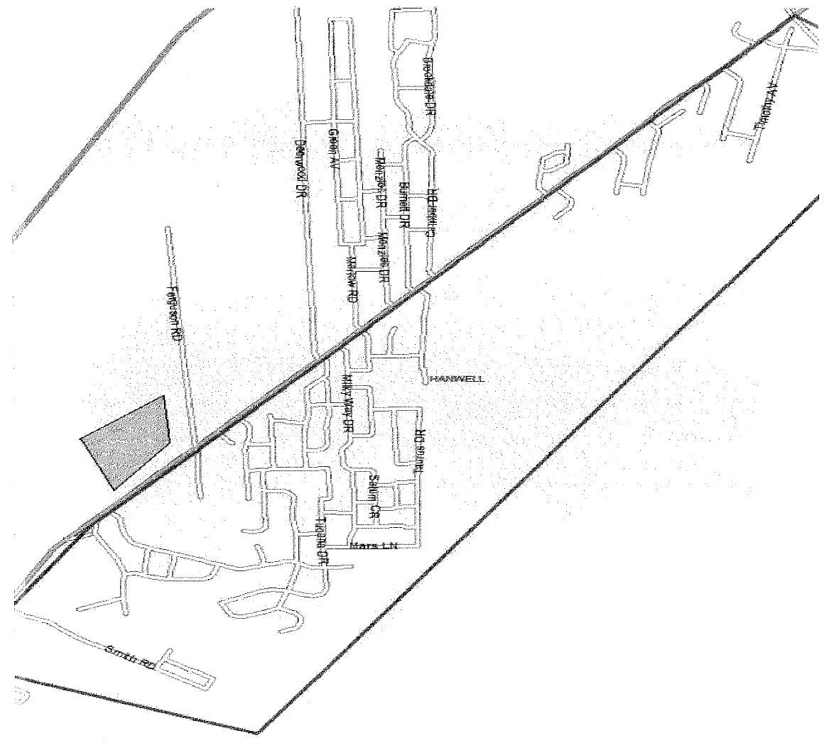
Map of Hanwell Scenario

